Slide 1

Bayesian Models
Payam Barnaghi
Department of Brain Sciences &
School of Convergence Science (Human and Artificial Intelligence)
Imperial College London
January 2026
Notes:
1

Slide 2
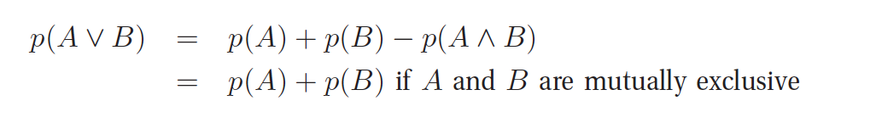
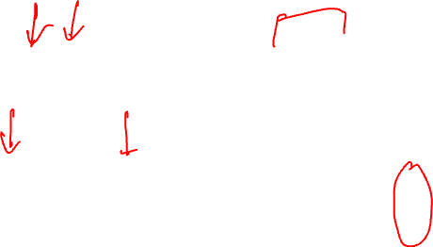
Probability of a union of two events
Given two events, A and B, we define the probability of A or B as follows:
A
B
A
B

Slide 3
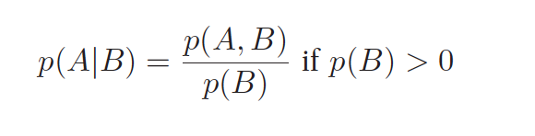
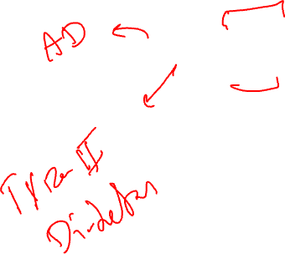
Conditional probability
We define the conditional probability of event A, given that event B is true, as follows:
A
B
p(A,B)

Slide 4
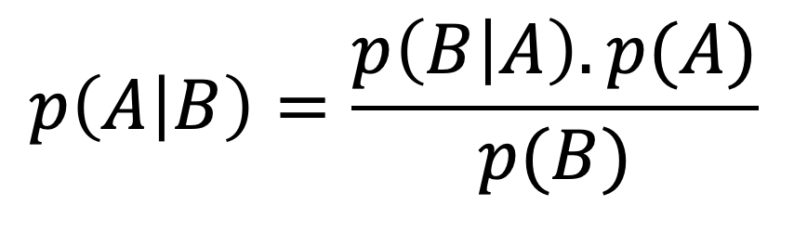
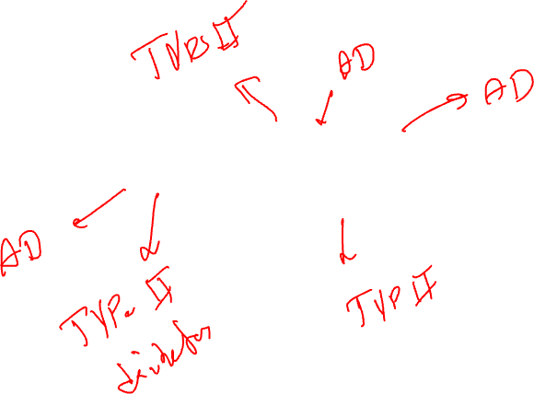
The Bayes rule
Likelihood
Prior
Posterior
$$p\left(A | B\right)=\frac{p\left(B | A\right). p(A)}{p(B)}$$
Marginalisation

Slide 5
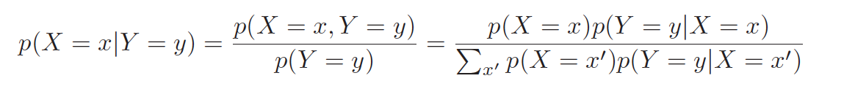
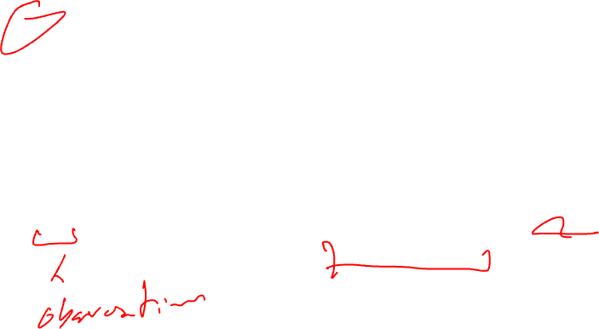
Bayes theorem*
Combining the definition of conditional probability with the product and sum rules yields the Bayes rule, also called the Bayes theorem:

Slide 6
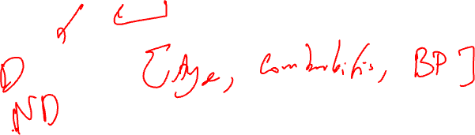
Bayesian Classification
Naive Bayes classifiers are built on Bayesian classification methods.
These rely on Bayes's theorem, which describes the relationship of conditional probabilities of statistical quantities.
In Bayesian classification, we are interested in finding the probability of a label given some observed features, which we can write as P( label | features).
Source: Python Data Science Handbook by Jake VanderPlas, O'Reilly Media, 2016.

Slide 7
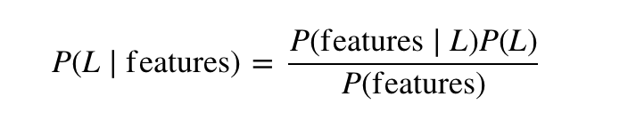
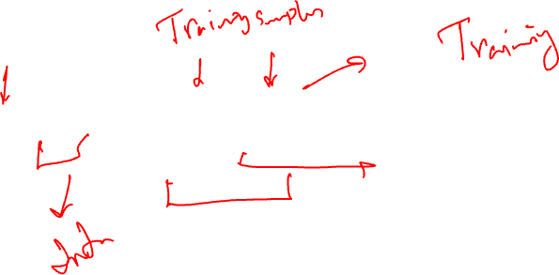
Naïve Bayes
We call it Naïve because it assumes that all the features are independent. In practice, this is not always true, but this assumption allows us to apply the Bayesian theorem:

Slide 8

Assumptions in Naïve Bayes
We assume that the features are:
Independent, given the outcome
The assumption is not correct in the real world, but the models we can build are often useful in practice (with caution).

Slide 9
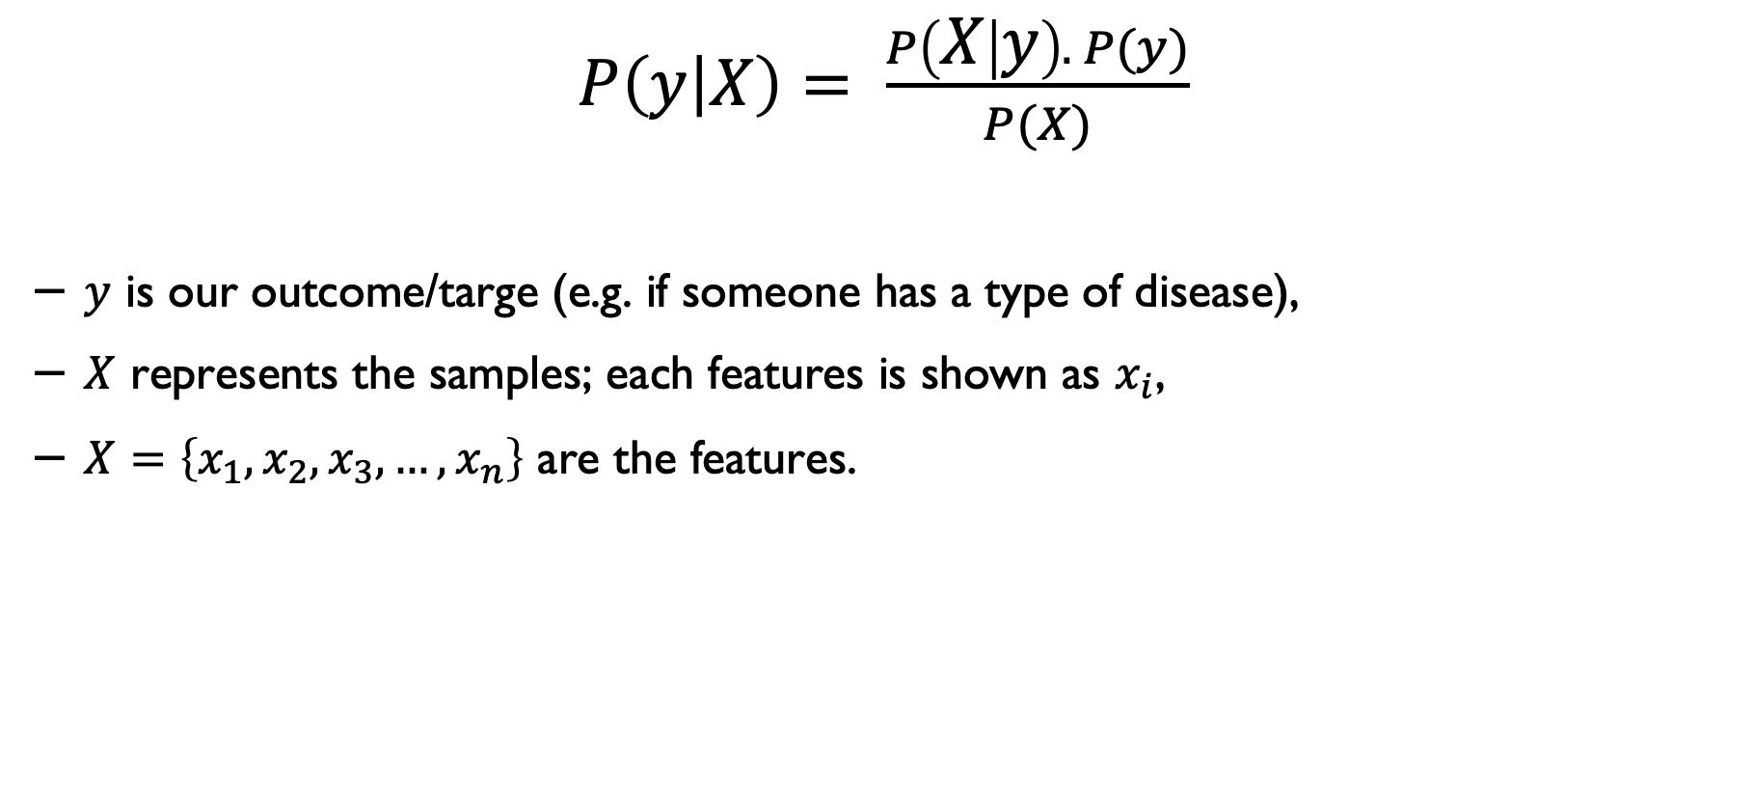
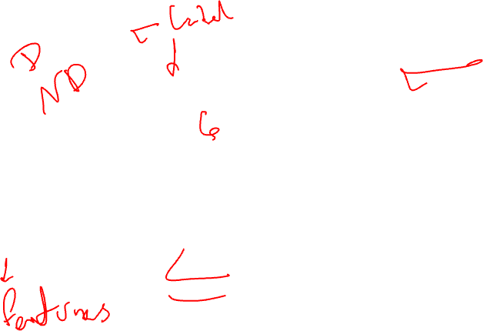
Bayes rule
$P\left(y | X\right)= \frac{P\left(X | y\right). P(y)}{P(X)}$
$y$ is our outcome/targe (e.g. if someone has a type of disease),
$X$ represents the samples; each features is shown as $x_{i}$,
$X=\left\{x_{1},x_{2},x_{3}, …,x_{n}\right\}$ are the features.

Slide 10
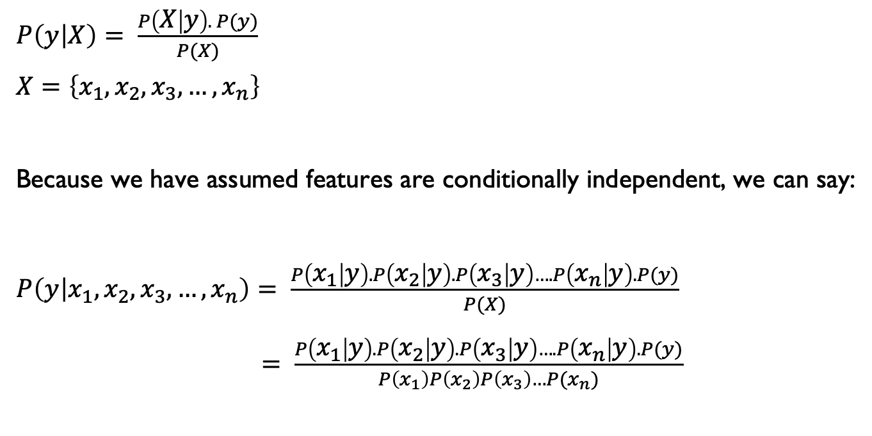
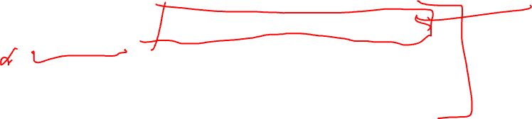
Determining Naïve Bayes
$P\left(y | X\right)= \frac{P\left(X | y\right). P(y)}{P(X)}$
$$X=\left\{x_{1},x_{2},x_{3}, …,x_{n}\right\}$$
Because we have assumed features are conditionally independent, we can say:
$P\left(y | x_{1},x_{2},x_{3}, …,x_{n}\right)= \frac{P\left(x_{1} | y\right).P\left(x_{2} | y\right).P\left(x_{3} | y\right)….P\left(x_{n} | y\right).P(y)}{P(X)}$
$= \frac{P\left(x_{1} | y\right).P\left(x_{2} | y\right).P\left(x_{3} | y\right)….P\left(x_{n} | y\right).P(y)}{P\left(x_{1}\right)P\left(x_{2}\right)P\left(x_{3}\right)…P(x_{n})}$

Slide 11
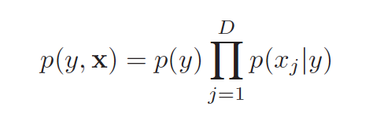
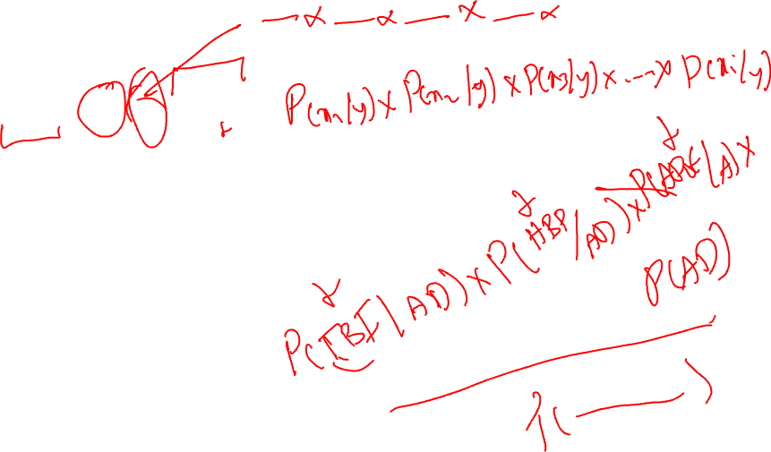
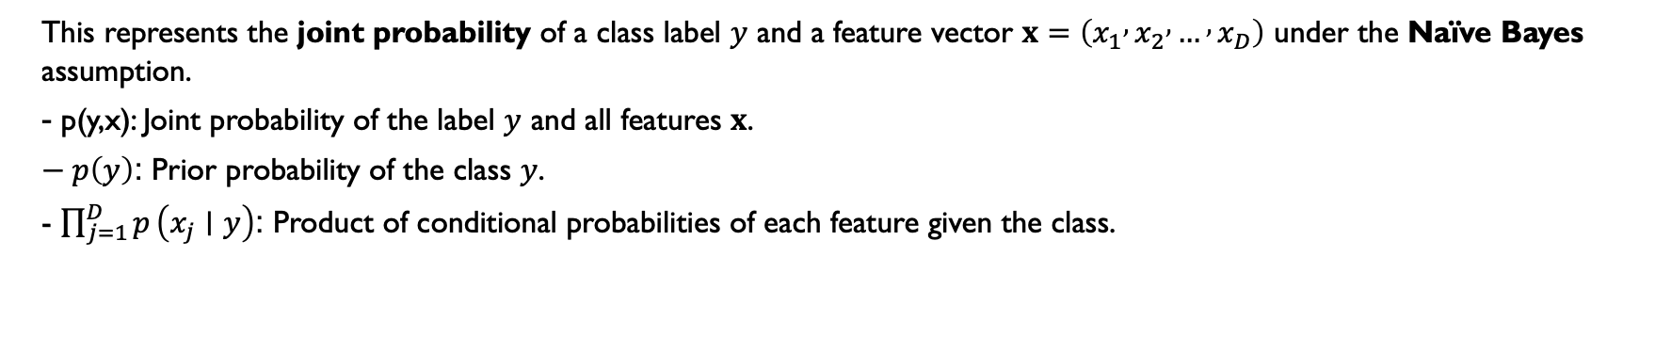
Let’s simplify
This represents the joint probability of a class label $y$ and a feature vector $x=\left(x_{1} , x_{2} , … , x_{D}\right)$ under the Naïve Bayes assumption.
- p(y,x): Joint probability of the label $y$ and all features $x$.
$− p\left(y\right)$: Prior probability of the class $y$.
- $\prod_{j=1}^{D}{p}\left(x_{j}∣y\right)$: Product of conditional probabilities of each feature given the class.
Notes:
p(y,x): Joint probability of the label $y$ and all features $x$.$p\left(y\right)$: Prior probability of the class $y$.$\prod_{j=1}^{D}{p}\left(x_{j}∣y\right)$: Product of conditional probabilities of each feature given the class.

Slide 12
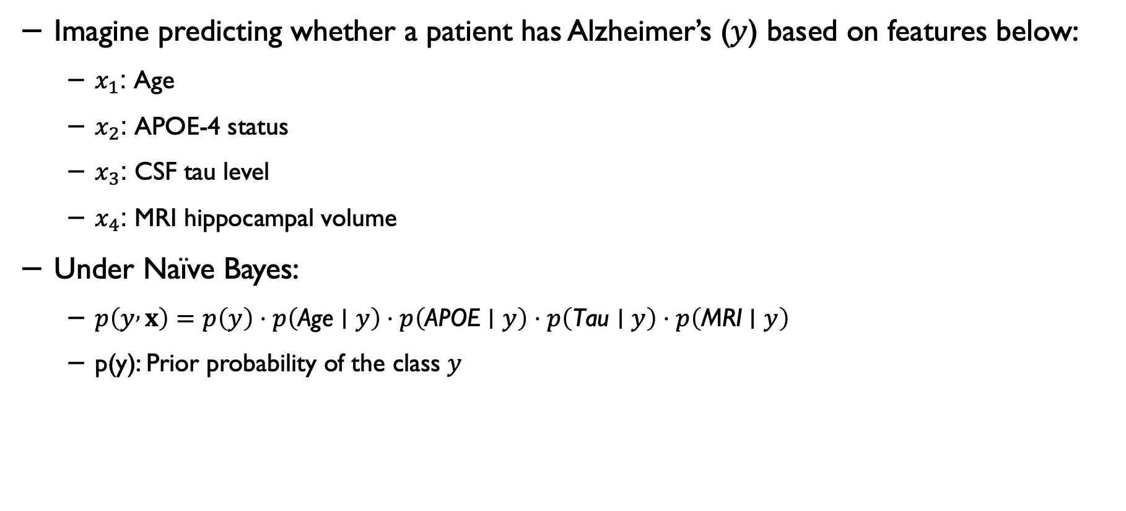
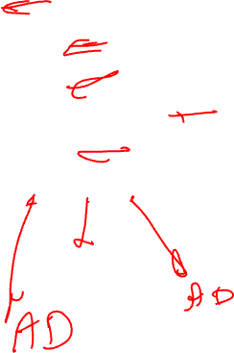
Example
Imagine predicting whether a patient has Alzheimer’s ($y$) based on features below:
$x_{1}$: Age
$x_{2}$: APOE-4 status
$x_{3}$: CSF tau level
$x_{4}$: MRI hippocampal volume
Under Naïve Bayes:
$p\left(y , x\right)=p\left(y\right)⋅p\left(\text{Age}∣y\right)⋅p\left(\text{APOE}∣y\right)⋅p\left(\text{Tau}∣y\right)⋅p\left(\text{MRI}∣y\right)$
p(y): Prior probability of the class $y$
Notes:
p(y): Prior probability of the class $y$.

Slide 13
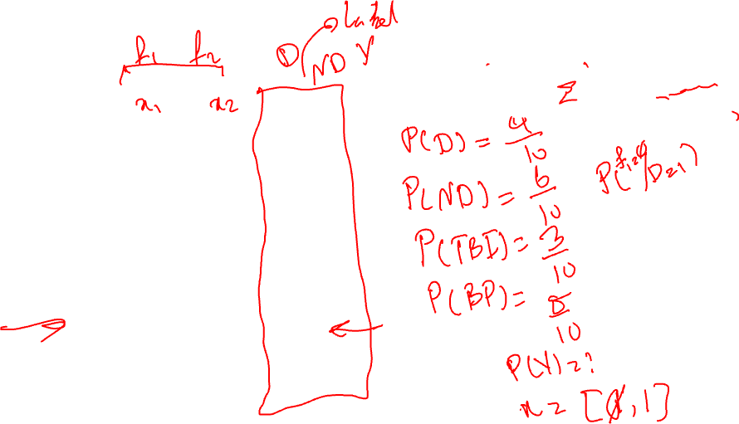
Naïve Bayes: example
P (disease =1) given [0,1]:
High BP
TBI
Disease
Patient #01 | 1 | 0 | 0
Patient #02 | 1 | 1 | 1
Patient #03 | 1 | 0 | 0
Patient #04 | 0 | 0 | 0
Patient #05 | 1 | 0 | 1
Patient #06 | 0 | 0 | 1
Patient #07 | 0 | 0 | 0
Patient #08 | 0 | 1 | 1
Patient #09 | 0 | 1 | 0
Patient #10 | 1 | 0 | 0
TBI: History of Traumatic Brain Injury; BP: Bloop Pressure

Slide 14
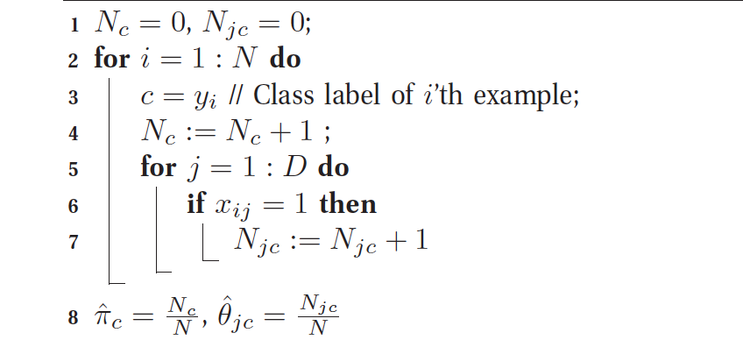
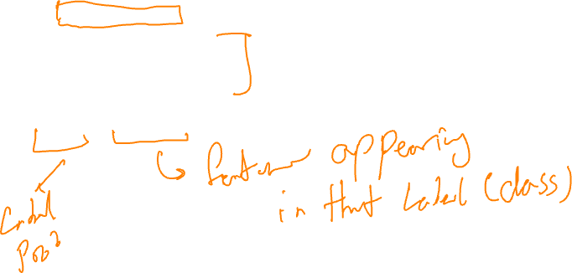
Algorithm for Naïve Bayes (with binary features)

Slide 15
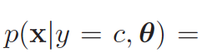
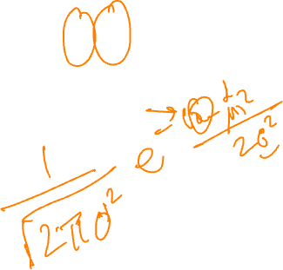
What about continuous variables?
For real-valued features, we typically model them using a Gaussian (normal) distribution:

Slide 16

Bayesian decision methods
Suppose we have an input vector x with a corresponding vector y of target variables.
Our goal is to predict y given a new value for x.
For a regression problem, y will contain continuous (real-valued) variables, and for a classification problem, y will represent class labels.

Slide 17
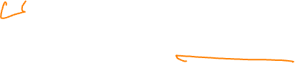
Joint probability
The joint probability distribution p(x,y) provides a summary of the uncertainty associated with these variables.
Determining p(x,y) from a set of training data is also referred to as inference.
Consider a medical diagnosis example: We have performed an MRI scan of a patient to determine whether the patient has a specific neurological disorder.

Slide 18

Medical diagnosis example
In the previous example, the input vector x is the set of pixels (or engineered features) from the scan.
y will represent the presence of the disease; for the presence of the disease, we show it, for example, with C₁, and for the absence of the disease, we note it as C_{2.}
The general inference problem then involves determining the join distribution p(x, C_{k})

Slide 19
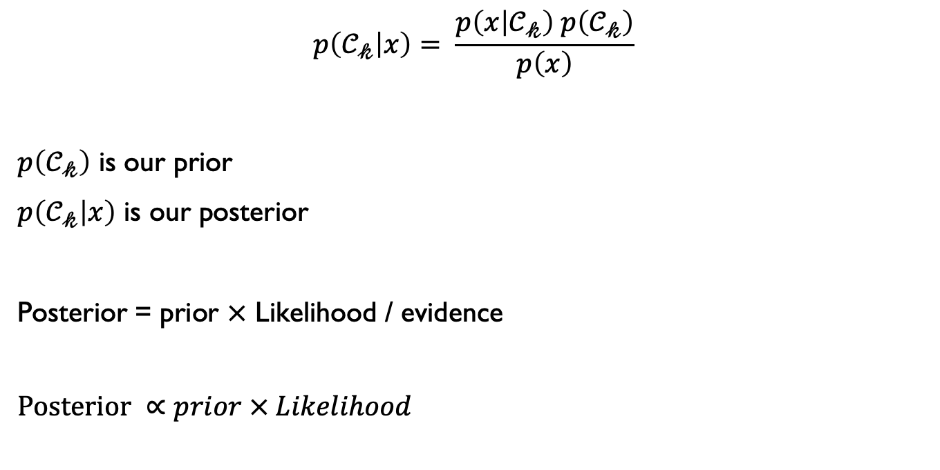
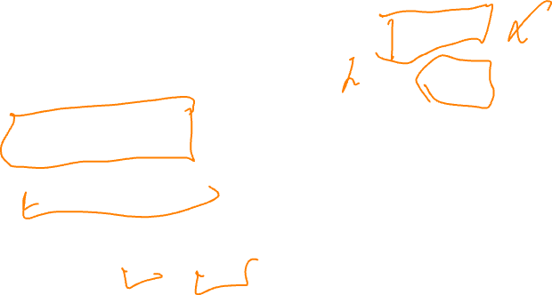
Example- applying Bayesian theorem
$$p\left(𝒞_{𝓀} | x\right)= \frac{p\left(x | 𝒞_{𝓀}\right) p\left(𝒞_{𝓀}\right)}{p\left(x\right)}$$
$p\left(𝒞_{𝓀}\right)$ is our prior
$p\left(𝒞_{𝓀} | x\right)$ is our posterior
Posterior = prior $×$ Likelihood / evidence
$$Posterior ∝prior × Likelihood$$

Slide 20
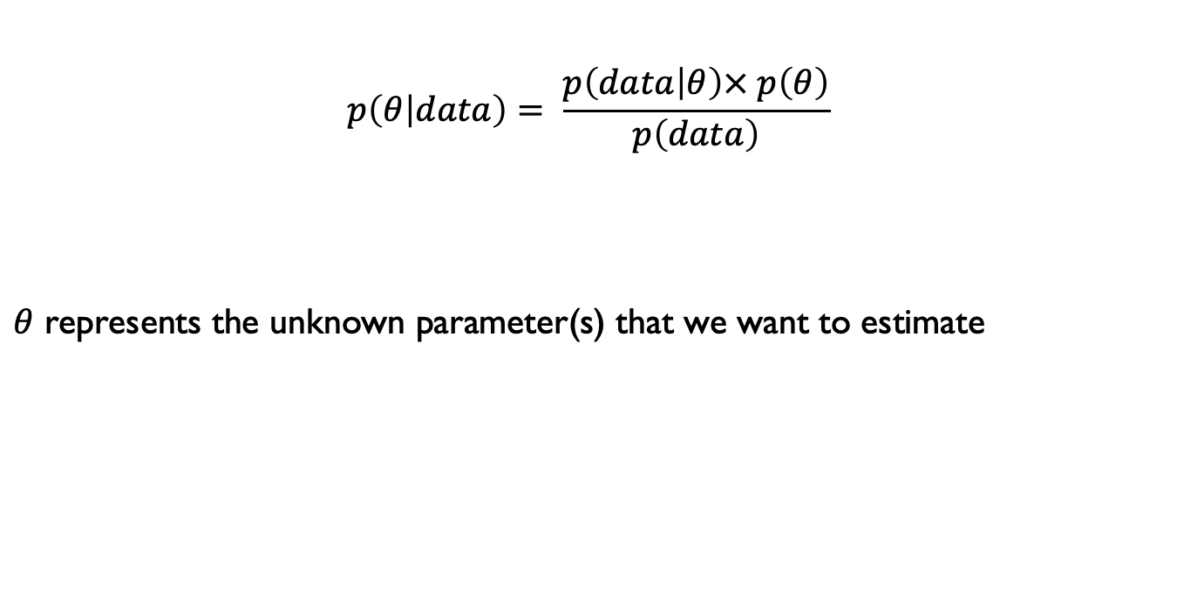
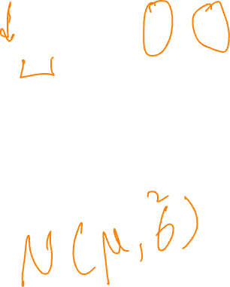
Bayesian inference
$$p\left(θ | data\right)= \frac{p\left(data | θ\right)× p\left(θ\right)}{p\left(data\right)}$$
$θ$ represents the unknown parameter(s) that we want to estimate

Slide 21
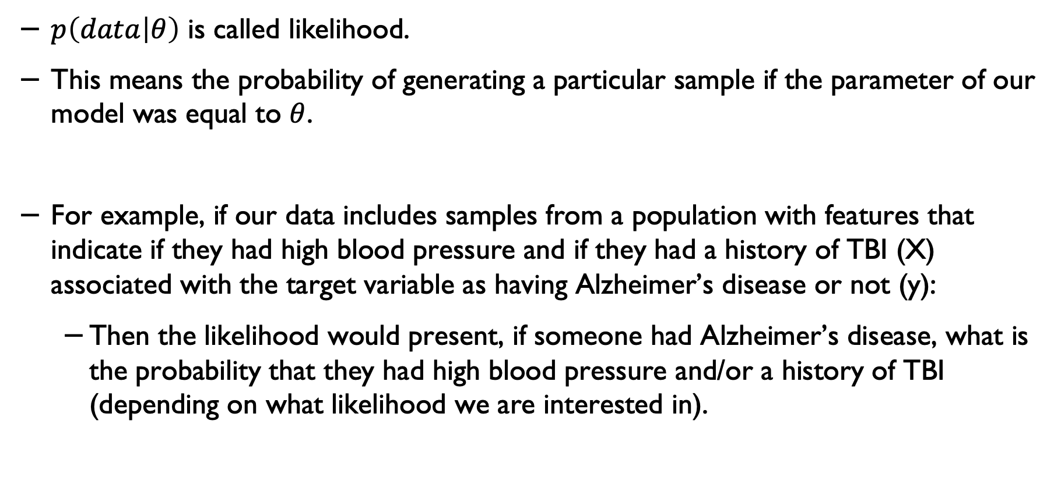
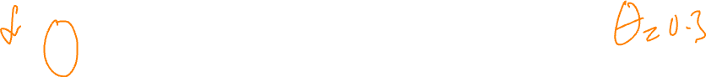
Likelihood
$p\left(data | θ\right)$ is called likelihood.
This means the probability of generating a particular sample if the parameter of our model was equal to $θ$.
For example, if our data includes samples from a population with features that indicate if they had high blood pressure and if they had a history of TBI (X) associated with the target variable as having Alzheimer’s disease or not (y):
Then the likelihood would present, if someone had Alzheimer’s disease, what is the probability that they had high blood pressure and/or a history of TBI (depending on what likelihood we are interested in).

Slide 22

Maximum likelihood*
In principle, we define the likelihood function and then calculate the parameter values that maximise the likelihood of observing our data.
In other words, in the previous example, p(data│θ), we assumed we knew the parameter θ, but what if we used a method to identify the value(s) of θ that maximise the likelihood of obtaining the data?
For example, in the case of a disease, we may not know its prevalence in the population in advance.

Slide 23
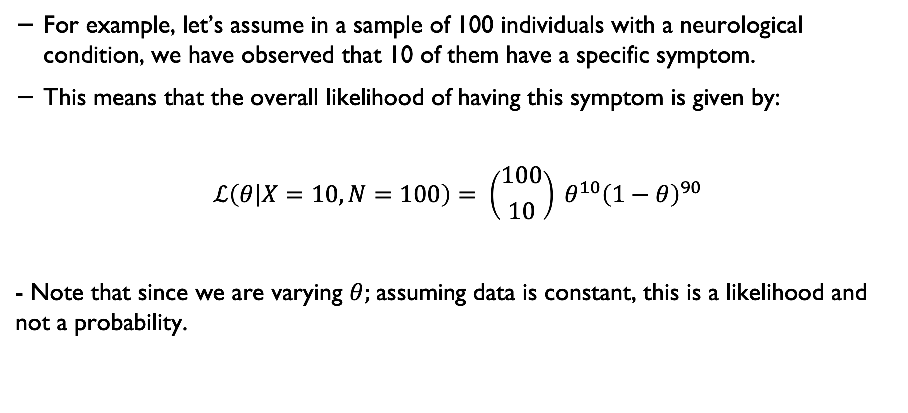
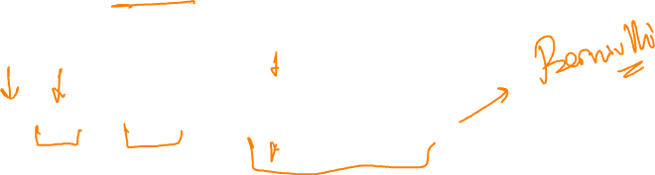
Estimating the maximum likelihood*
For example, let’s assume in a sample of 100 individuals with a neurological condition, we have observed that 10 of them have a specific symptom.
This means that the overall likelihood of having this symptom is given by:
$$ℒ\left(θ | X=10, N=100\right)= \left({100 \atop 10}\right) θ^{10}{\left(1−θ\right)}^{90}$$
- Note that since we are varying $θ;$assuming data is constant, this is a likelihood and not a probability.

Slide 24
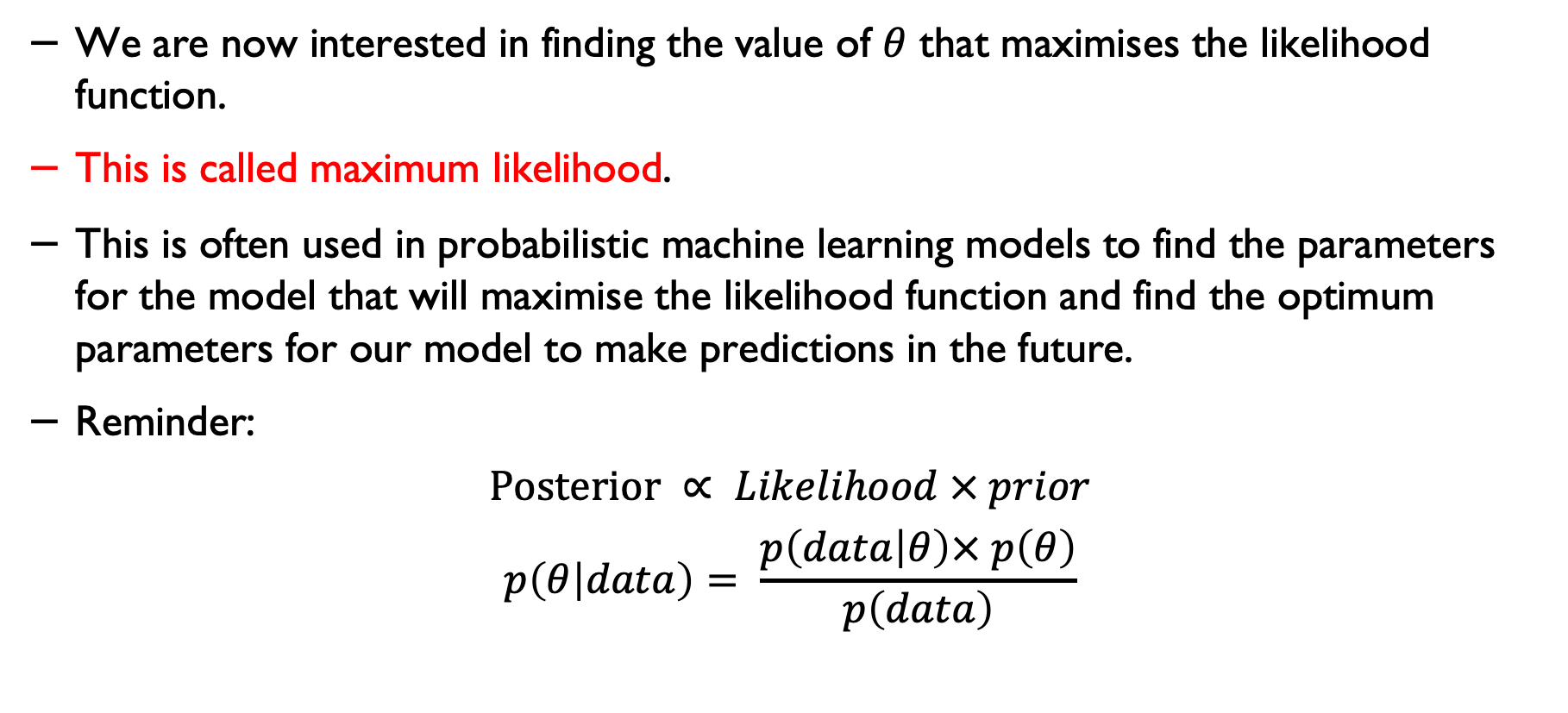
Estimating the maximum likelihood*
We are now interested in finding the value of $θ$ that maximises the likelihood function.
This is called maximum likelihood.
This is often used in probabilistic machine learning models to find the parameters for the model that will maximise the likelihood function and find the optimum parameters for our model to make predictions in the future.
Reminder:
$$Posterior ∝ Likelihood × prior$$
$$p\left(θ | data\right)= \frac{p\left(data | θ\right)× p\left(θ\right)}{p\left(data\right)}$$

Slide 25
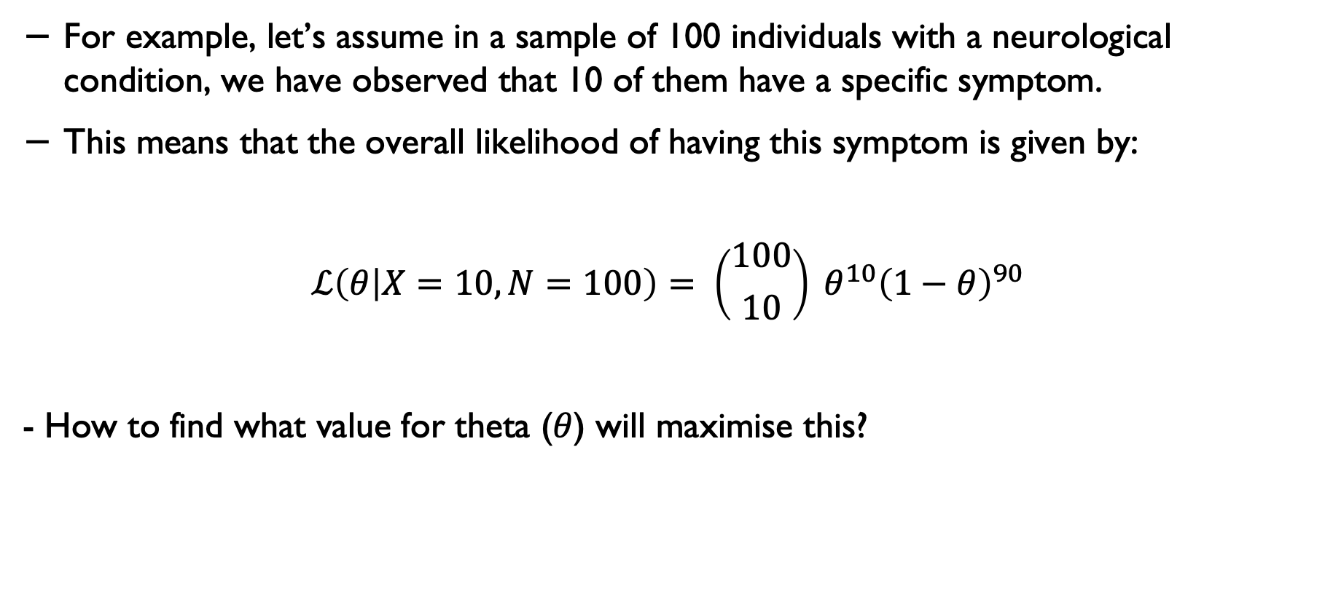
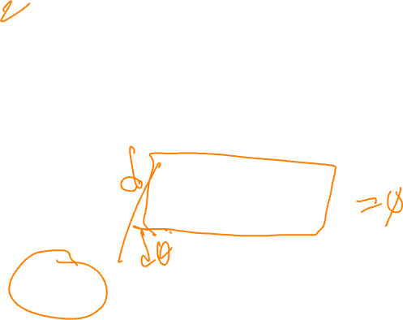
Repeating our example*
For example, let’s assume in a sample of 100 individuals with a neurological condition, we have observed that 10 of them have a specific symptom.
This means that the overall likelihood of having this symptom is given by:
$$ℒ\left(θ | X=10, N=100\right)= \left({100 \atop 10}\right) θ^{10}{\left(1−θ\right)}^{90}$$
- How to find what value for theta ($θ$) will maximise this?

Slide 26
Log likelihood*
Before we continue with the next few slides:
I don’t expect you to know or use the maths discussed here- this is just added for your information and for those who might be interested in pursuing Bayesian methods further.
Most modern libraries will automatically train/learn your model and optimise its parameters, including the models we will use in our lab experiments.

Slide 27
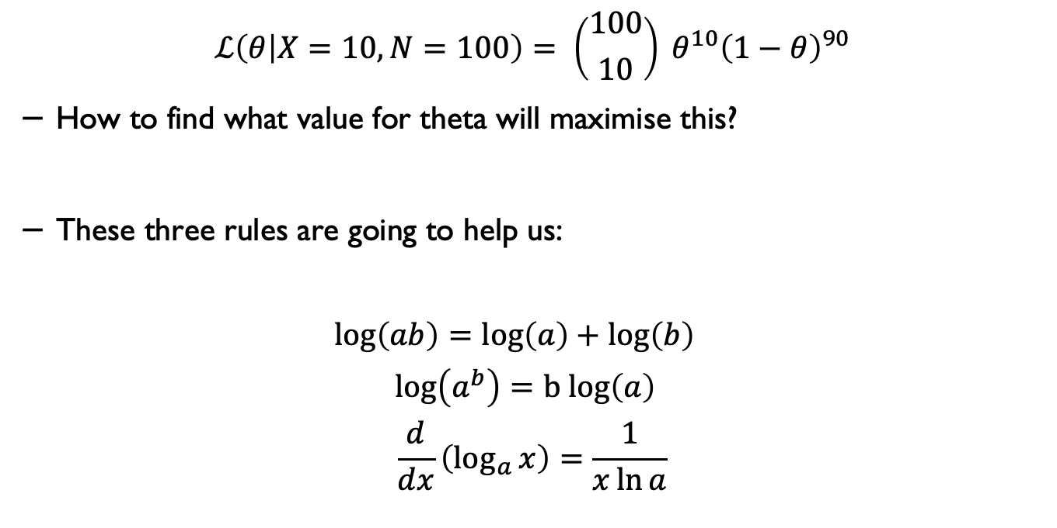
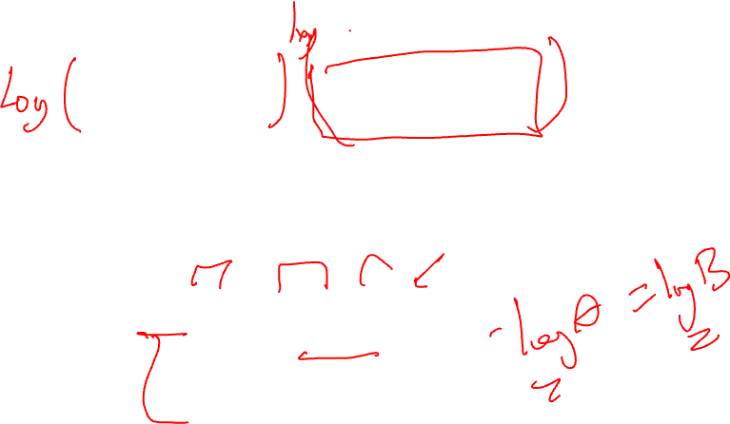
Log likelihood*
$$ℒ\left(θ | X=10, N=100\right)= \left({100 \atop 10}\right) θ^{10}{\left(1−θ\right)}^{90}$$
How to find what value for theta will maximise this?
These three rules are going to help us:
$$\log\left(ab\right)=\log\left(a\right)+\log\left(b\right)$$
$$\log\left(a^{b}\right)=b log\left(a\right)$$
$$\frac{d}{dx}\left(\log_{a}{x}\right)=\frac{1}{x\ln{a}}$$

Slide 28
Maximising the Log likelihood*
To maximise the likelihood, calculate the log-likelihood, take the derivative and then set it equal to zero.
We calculate the log-likelihood for simplicity of working with sums (+) instead of multiplications (x) [needed for the step below]
We take the first derivative and set it to zero because the first derivative will give us the slope of change;
And setting it to zero will give you the point that the point that the function is maximised.

Slide 29
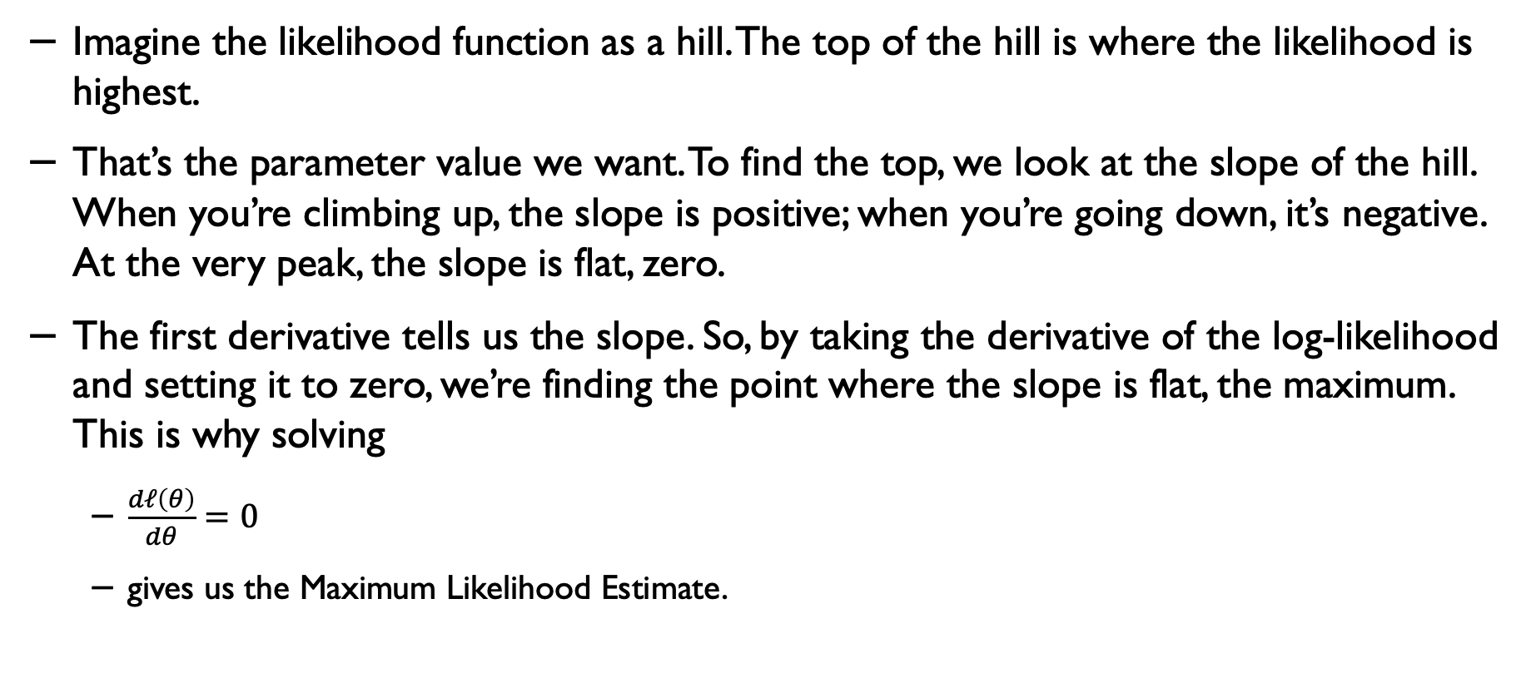

Why do we take the first derivative and set it to zero?
Imagine the likelihood function as a hill. The top of the hill is where the likelihood is highest.
That’s the parameter value we want. To find the top, we look at the slope of the hill. When you’re climbing up, the slope is positive; when you’re going down, it’s negative. At the very peak, the slope is flat, zero.
The first derivative tells us the slope. So, by taking the derivative of the log-likelihood and setting it to zero, we’re finding the point where the slope is flat, the maximum. This is why solving
$\frac{dℓ\left(θ\right)}{dθ}=0$
gives us the Maximum Likelihood Estimate.

Slide 30
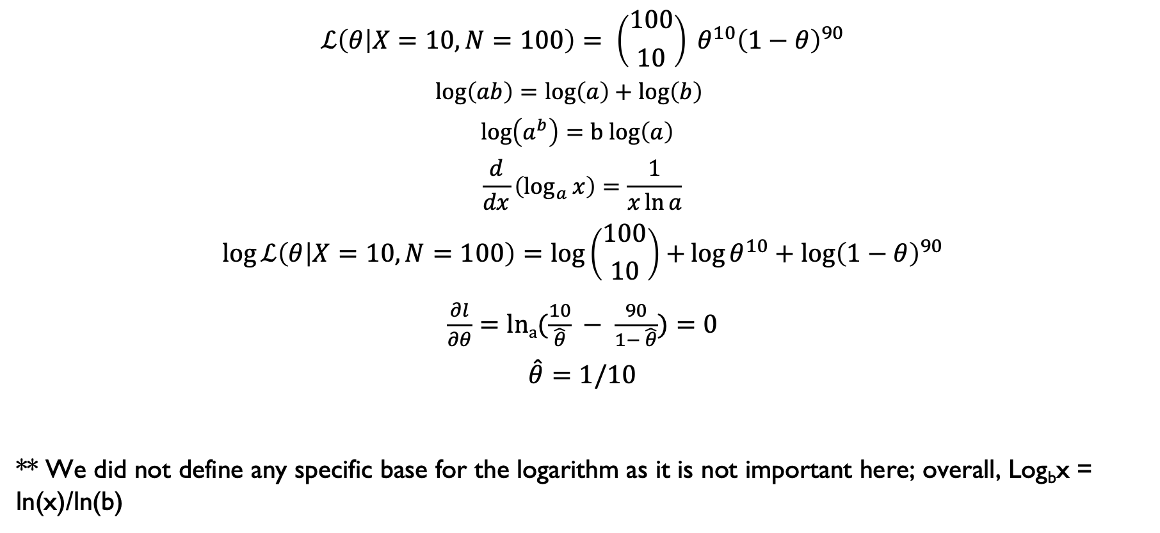
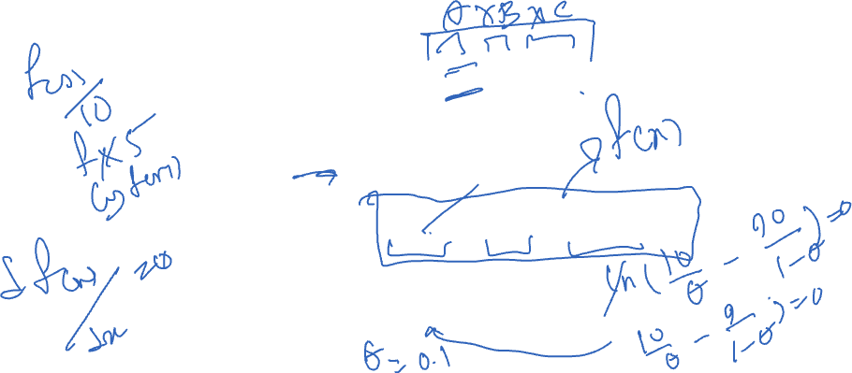
Maximising the Log likelihood*
$$ℒ\left(θ | X=10, N=100\right)= \left({100 \atop 10}\right) θ^{10}{\left(1−θ\right)}^{90}$$
$$\log\left(ab\right)=\log\left(a\right)+\log\left(b\right)$$
$$\log\left(a^{b}\right)=b log\left(a\right)$$
$$\frac{d}{dx}\left(\log_{a}{x}\right)=\frac{1}{x\ln{a}}$$
$$\log{ℒ\left(θ | X=10, N=100\right)}=\log\left({100 \atop 10}\right)+\log{θ^{10}+\log{{\left(1−θ\right)}^{90}}}$$
$\frac{∂l}{∂θ}=lna(\frac{10}{\hat{θ}} − \frac{90}{1− \hat{θ}})=0$
$$\hat{θ}=1/10$$
** We did not define any specific base for the logarithm as it is not important here; overall, Log_{b}x = ln(x)/ln(b)

Slide 31
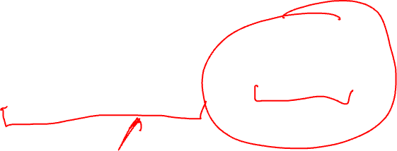
Naïve Bayes in python
It required a small amount of training data to estimate the necessary parameters.
Naïve Bayes learners and classifiers can be very fast compared to more sophisticated methods.
On the other hand, although naïve Bayes is known as a useful classifier, it is known to be a bad estimator, so the probability outputs from predict_proba (in Pythin scikit-learn) are not to be taken too seriously.
Source: https://scikitlearn.org/stable/modules/naive_bayes.html

Slide 32
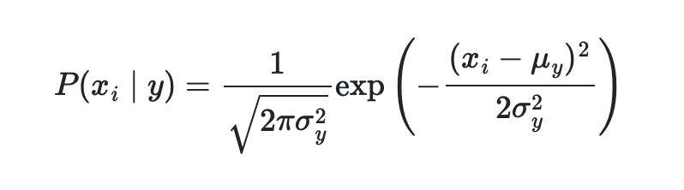
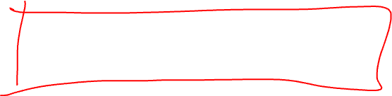
Naïve Bayes in python
Gaussian Naive Bayes:
GaussianNB implements the Gaussian Naive Bayes algorithm for classification. The likelihood of the features is assumed to be Gaussian:
The parameters σ_{y} and μ_{y} are estimated using maximum likelihood.
Source: https://scikitlearn.org/stable/modules/naive_bayes.html

Slide 33
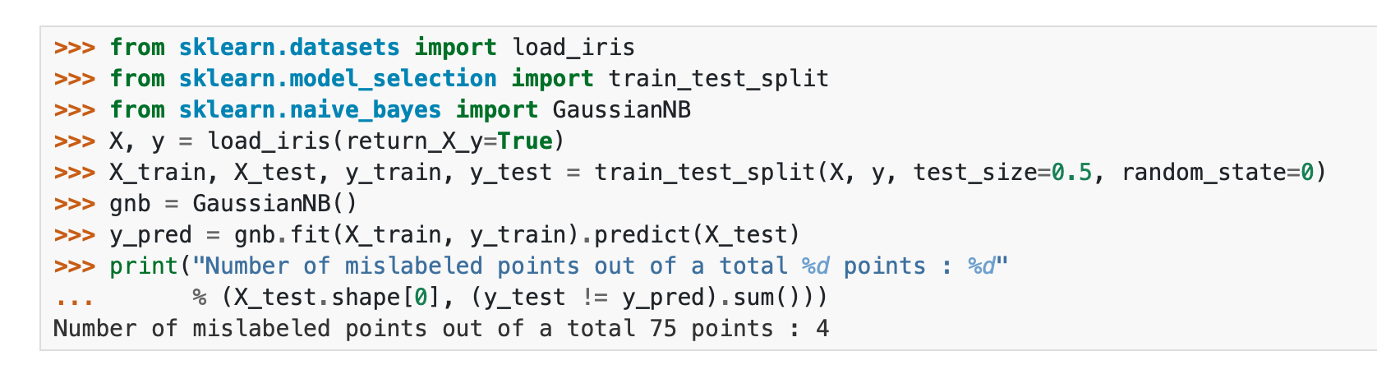
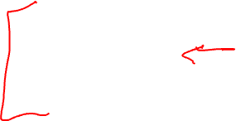
Gaussian Naïve Bayes
Source: https://scikitlearn.org/stable/modules/naive_bayes.html

Slide 34

Multinomial Naïve Bayes
MultinomialNB implements the naïve Bayes algorithm for multinomially distributed data and is one of the two classic naïve Bayes variants used in text classification.
The distribution is parametrised by vectors θy=(θ_{y1},…,θ_{yn}) for each class y, where n is the number of features and θyi is the probability P(x_{i}∣y) of feature i appearing in a sample belonging to class y.
The parameters θy are estimated by a smoothed version of maximum likelihood, i.e. relative frequency counting.
Source: https://scikitlearn.org/stable/modules/naive_bayes.html

Slide 35
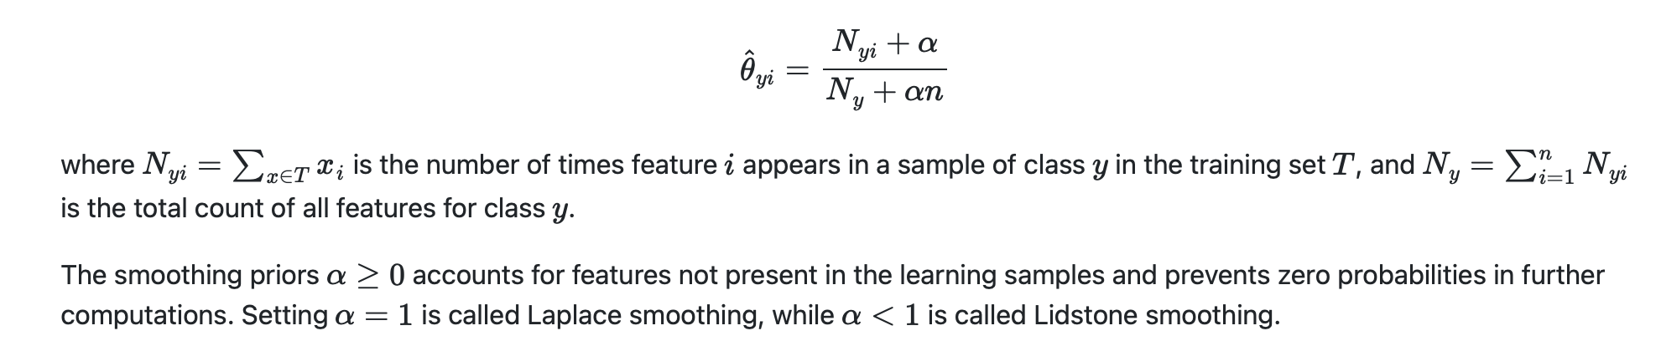
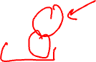
Multinomial Naïve Bayes*
The parameters θy is estimated by a smoothed version of maximum likelihood, i.e. relative frequency counting:
Source: https://scikitlearn.org/stable/modules/naive_bayes.html

Slide 36
Evaluation metrics

Slide 37
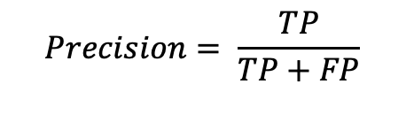

Precision and Recall
Precision defines the proportion of positive identifications that have actually been correct.
TP = True Positive
FP = False Positive
$$Precision= \frac{TP}{TP+FP}$$
Example: Calculate the Precision
True Positives: 25 | False Positives: 10
False Negatives: 15 | True Negatives: 80

Slide 38


Recall
Recall defines the proportion of actual positives that were identified correctly.
TP = True Positive
FN = False Negative
$$Recall= \frac{TP}{TP+FN}$$
Example: Calculate the Recall
True Positives: 25 | False Positives: 10
False Negatives: 15 | True Negatives: 80

Slide 39




Precision and Recall
How the decision threshold could affect Precision and Recall.
This can be very important in medical applications.
Image source: https://developers.google.com/machine-learning/crash-course/classification/precision-and-recall

Slide 40



Accuracy
Accuracy is a metric to evaluate classification models.
It shows the fraction of predictions that the model has made correctly.
$$Accuracy= \frac{Number of correct predictions}{Total number of predictions}$$
$$Accuracy= \frac{TP+TN}{TP+TN+FP+FN}$$

Slide 41
Accuracy – how to interpret it
Accuracy could be a misleading metric without sufficient (other) complementary information.
Imagine we have a model that has classified a total of 100 tumours as malignant (the positive class) or benign (the negative class).
If someone tells you that the accuracy of the model is 91%, is that good?
source: https://developers.google.com/machine-learning/crash-course/classification/precision-and-recall

Slide 42
Accuracy interpretation example
Of the 100 tumour examples, 91 are benign (90 TNs and 1 FP), and 9 are malignant (1 TP and 8 FNs).
Of the 91 benign tumours, the model correctly identifies 90 as benign. That's good.
However, of the 9 malignant tumours, the model only correctly identifies 1 as malignant, not a good outcome, as 8 out of 9 malignancies go undiagnosed!
source: https://developers.google.com/machine-learning/crash-course/classification/precision-and-recall

Slide 43


F₁ Score
F₁ score is the harmonic mean of precision and recall.
$$F1=2 × \frac{Precision × Recall}{Precision +Recall}$$
Example: Calculate the F₁ score
True Positives: 25 | False Positives: 10
False Negatives: 15 | True Negatives: 80

Slide 44


ROC curve (receiver operating characteristic curve)
A ROC curve (receiver operating characteristic curve) is a graph showing the performance of a classification model at all classification thresholds. This curve plots two parameters:
True Positive Rate (TPR)
False Positive Rate (FPR)
Does this look familiar?
$$TPR= \frac{TP}{TP+FN}$$
source: https://developers.google.com/machine-learning/crash-course/classification/precision-and-recall

Slide 45


ROC curve
A ROC curve plots TPR vs. FPR at different classification thresholds. Lowering the classification threshold classifies more items as positive, thus increasing both False Positives and True Positives.
source: https://developers.google.com/machine-learning/crash-course/classification/precision-and-recall

Slide 46


AUC: Area Under the ROC Curve
AUC stands for "Area under the Curve."
In this case, AUC measures the entire two-dimensional area underneath the entire ROC curve.
AUC provides an aggregate measure of performance across all possible classification thresholds.
Please note that there is also an AUC for Precision-Recall Curve
source: https://developers.google.com/machine-learning/crash-course/classification/precision-and-recall

Slide 47

PR AUC vs ROC AUC
- PR AUC:
Evaluating performance based on positive class
Better suited for imbalanced data,
Precision vs. Recall
- ROC AUC:
Evaluating overall classification performance,
It can be misleading for imbalanced data,
TPR vs. FPR

Slide 48
Cases that AUC could be useful
AUC is desirable for the following two reasons:
AUC is scale-invariant. It measures how well predictions are ranked rather than their absolute values.
AUC is classification-threshold invariant. It measures the quality of the model's predictions regardless of the classification threshold chosen.
source: https://developers.google.com/machine-learning/crash-course/classification/precision-and-recall

Slide 49

Cases that AUC will NOT be useful
Scale invariance is not always desirable. For example, sometimes, we really do need well-calibrated probability outputs, and AUC won’t tell us about that.
Classification-threshold invariance is not always desirable. In cases where there are wide disparities in the cost of false negatives vs. false positives, it may be critical to minimise one type of classification error. For example, in a medical test, FPs and FNs do not carry equal weights. AUC may not be a useful metric for this type of optimisation.
source: https://developers.google.com/machine-learning/crash-course/classification/precision-and-recall

Slide 50

Prediction bias
Some of the reasons:
The training set doesn't adequately represent certain subsets of the data space.
Some subsets of the data set are noisier than others.
The model is overly regularised.

Slide 51



Sensitivity and specificity
Sensitivity: the ability of a test to correctly identify patients with a disease.
Specificity: the ability of a test to correctly identify people without the disease.
Prevalence: the percentage of people in a population who have the condition of interest.
$$Sensetivity= \frac{TP}{TP+FN}$$
$$Specificity= \frac{TN}{TN+FP}$$
Source: Swift A, Heale R, Twycross A, What are sensitivity and specificity?, Evidence-Based Nursing 2020;23:2-4.

Slide 52


Sensitivity/Specificity: Example
$$Sensetivity= \frac{TP}{TP+FN}$$
$$Specificity= \frac{TN}{TN+FP}$$
Example: Calculate the sensitivity and specificity
True Positives: 25 | False Positives: 10
False Negatives: 15 | True Negatives: 80

Slide 53



Specificity and Sensitivity
Source: https://en.wikipedia.org/wiki/Sensitivity_and_specificity

Slide 54


Confusion matrix

Slide 55



Youden’s index
Captures the “informed-ness” measure.
The classification thresholds can be selected to maximise informedness.
$$J= Sensetivity+Specificity −1$$
Solid red: ROC curve; Dashed line: Chance level; Vertical line (J) maximum value of Youden's index for the ROC
Source: https://en.wikipedia.org/wiki/Youden%27s_J_statistic

Slide 56

Probability calibration
Sometimes, in classification, you may want to predict the class label as well as the probability of the label for that class.
This probability will provide an estimate/measure of the prediction.
You need to be aware that some models can produce poor estimates of class probabilities (e.g., Naïve Bayes).
Calibrating a classifier consists of fitting a regressor (called a calibrator) that maps the output of the classifier to a calibrated probability in [0, 1].
Denoting the output of the classifier for a given sample by f_{i}, the calibrator tries to predict p(y_{i}=1|f_{i}).
See: https://scikit-learn.org/stable/modules/calibration.html

Slide 57





All in one place
$$Precision= \frac{TP}{TP+FP}$$
$$F1=2 × \frac{Precision × Recall}{Precision +Recall}$$
$$Recall= \frac{TP}{TP+FN}$$
$$Accuracy= \frac{TP+TN}{TP+TN+FP+FN}$$
$$Sensetivity= \frac{TP}{TP+FN}$$
$$Specificity= \frac{TN}{TN+FP}$$

Slide 58

Open discussion
Imagine a hospital deploying an AI model to predict which patients are likely to be readmitted within 30 days. The goal is to allocate extra care resources to high-risk patients.
Initial Metric: The team optimises for overall accuracy and achieves 92%. Everyone celebrates.
Hidden Problem: When they break down performance by demographic groups:
Accuracy for younger patients: 95%
Accuracy for older patients: 88%
Was accuracy the right metric?

Slide 59
Review Questions

Slide 60
Q1
Imagine you come across a model for which its accuracy is specified as 91%; is that good?
menti code will be provided.

Slide 61
Q2
Imagine you are developing a screening tool for the risk of Alzheimer's disease using electronic healthcare records (EHR) data. You will implement an ML model to process historical medical records. Which metric will give you a higher weight (if any)?

Slide 62
Metric in Scikit-learn
Metrics and scoring:
https://scikit-learn.org/stable/modules/model_evaluation.html#confusion-matrix

Slide 63
Acknowledgments
The slides on likelihood estimation are adapted from “A student’s guide to Bayesian Statistics) by Ben Lambert, SAGE, 2019.
Some of the slides on Bayesian models and equations are adapted from Kevin Murphy’s book:
Machine Learning: A Probabilistic Perspective Kevin P. Murphy, MIT Press.

Slide 64
If you have any questions
Please feel free to arrange a meeting or email (p.barnaghi@imperial.ac.uk).
To arrange a meeting, please email my colleague, Ms Rhiannon Kirby.
My office: 928, Sir Michael Uren Research Hub, White City Campus.

